Slide 1
HISTOPATHOLOGIC CANCER DETECTION： IDENTIFY METASTATIC TISSUE IN HISTOPATHOLOGIC SCANS OF LYMPH NODE SECTIONS
Group B
Rahaman, Mahaboob Shahana ( mr1520 ), Hu, Hanxin ( hh497 ),Liao, Junhui ( jl2512 )

Slide 2
1. Background
This dataset comes from a Kaggle computation: https://www.kaggle.com/c/histopathologic-cancer-detection.
In this competition, we are required to created an algorithm to identify metastatic cancer in small image patches taken from larger digital pathology scans. The data for this competition is a slightly modified version of the PatchCamelyon (PCam) benchmark dataset.
Why is it necessary: In recent years, image recognition using artificial intelligence (AI) with machine learning has dramatically improved and been increasingly applied to diagnostic imaging in various medical fields. AI algorithms with great predictive power can indeed augment the survival rate of patients.
Data descriptions and preparation
Model construction
Performance evaluation
Figure 1: the flowchart of this project

Slide 3

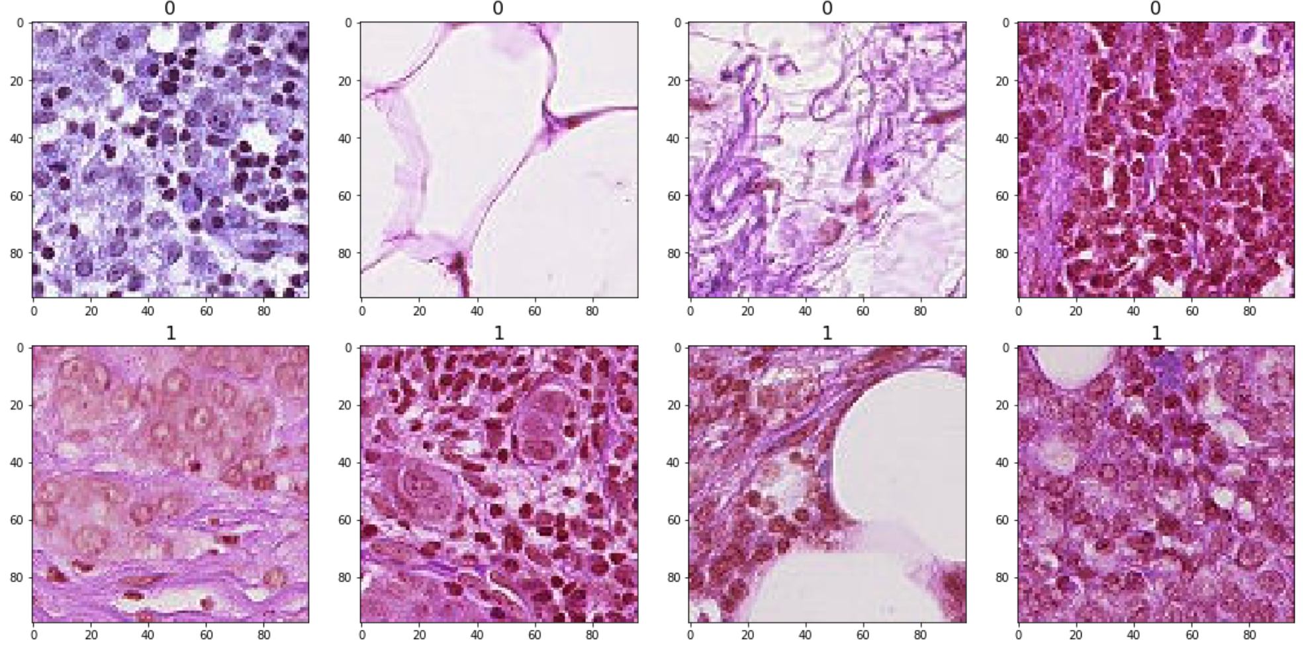
2. Data descriptions and preparation
The shape of our original dataset: 220,025 images and two labels (whether this image includes cancer).
Sample distribution: among all the images, 130, 908 images without cancer while 89,117 with cancer. Namely, this dataset is not unbalanced, and evaluation metric AUC is suitable in this context.
Visualization of these images:

Slide 4

2. Data descriptions and preparation
Undersampling: the rationale is to reduce the number of samples in class 0. In other words, the number of records in two different classes should be roughly equal with each other. Eventually, we have 80,000 instances for each group of images.
The separation of train set and validation set: according to stratified sampling (the test size is equal to 0.1), we have 144,000 samples in the train set and 16,000 samples in the test set.
Create several new directories and store images in the corresponding file:
.
a. Has tumor issue
Train directory (144,000)
b. No tumer issues
All the images (160,000)
a. Has tumor issue
Validation directory (16,000)
b. No tumor issue

Slide 5

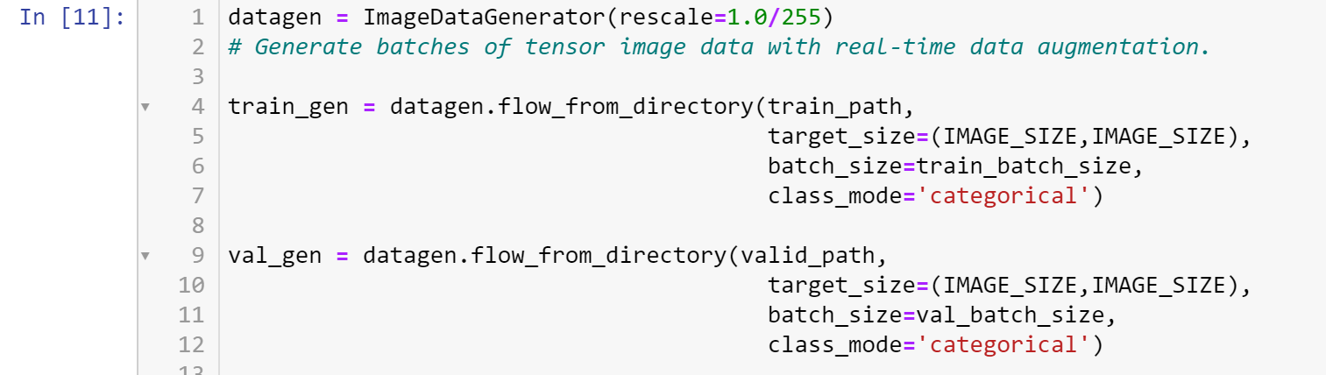
2. Data descriptions and preparation
Set up the generator (transfer target images into pixels): (1) read the picture files; (2) decode the JPEG content to RGB grids of pixels; (3) convert these into floating-point tensors; (4)rescale the pixel values (between 0 and 255) to the [0, 1] interval.
※ Note that the train step and validation step are separately equal to 14,400 and 1,600, aiming at improving computational speed.

Slide 6

3. Model construction
Library: keras2.1 with gpu
Gpu: RTX2080 with max_q design
5 models：
Alexnet with 0.3 dropout
Alexnet with 0.4 dropout
VGG13
VGG16
ResNet50 (with data augmentation and fine-tuning )

Slide 7
Alexnet with 0.3 drop out
Highest val_accuracy: 0.9277
Highest val_accuracy epoch：20th
Steady accuracy start: 8th
Typical epoch train time：176s

Slide 8
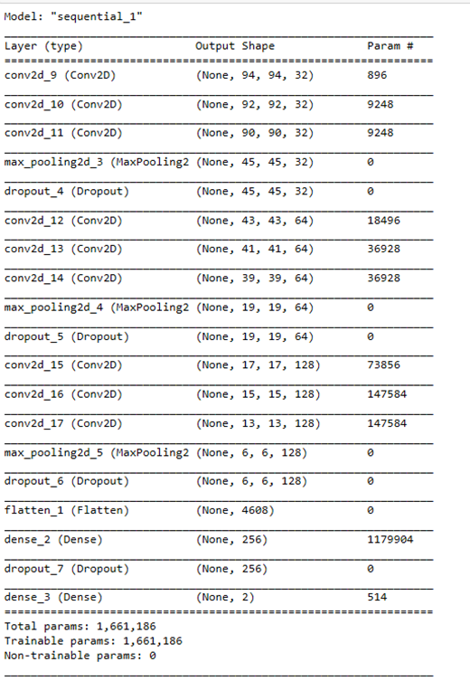
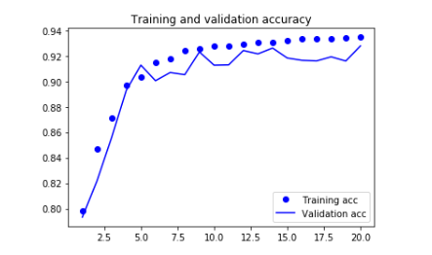
The network structure and train process

Slide 9
Alexnet with 0.4 drop out
Highest val_accuracy: 0.9027
Highest val_accuracy epoch：10th
Steady accuracy start：6th
Typical epoch train time：170s

Slide 10
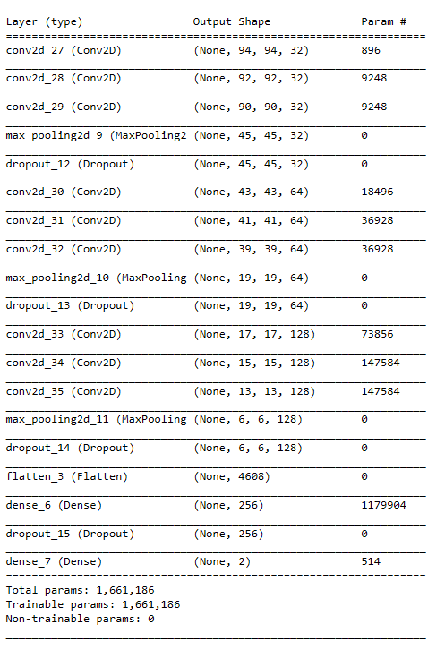
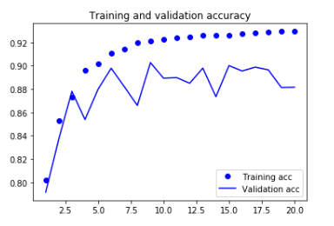
The network structure and train process

Slide 11
VGG 13
Highest val_accuracy: 0.8041
Highest val_accuracy epoch：6th
Steady accuracy start：3rd
Typical epoch train time：118s

Slide 12
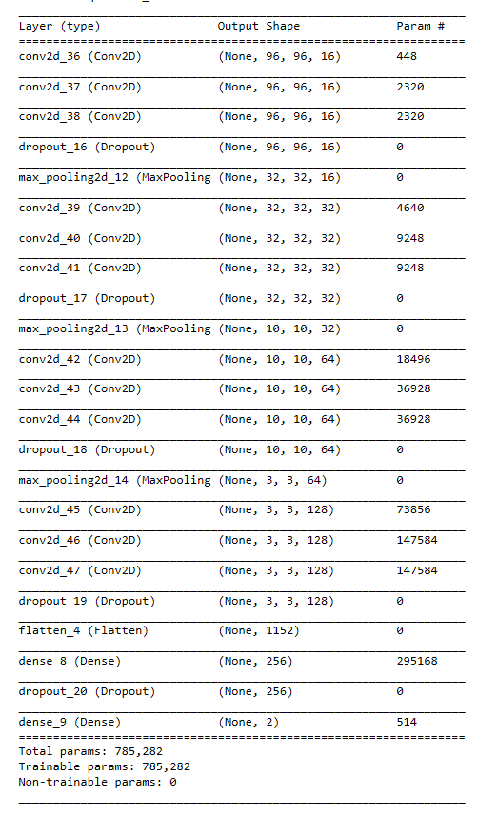
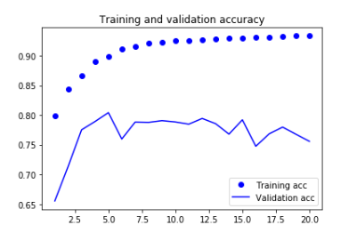
The network structure and train process

Slide 13
VGG 16
Highest val_accuracy: 0.8363
Highest val_accuracy epoch：4th
Steady accuracy start：4th
Typical epoch train time：145s

Slide 14
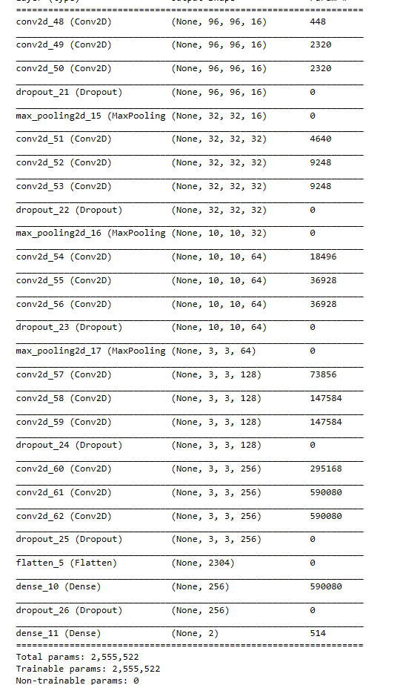
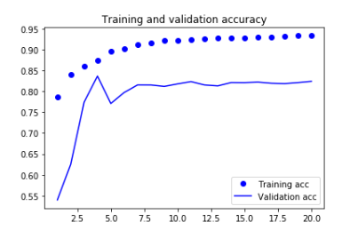
The network structure and train process

Slide 15
ResNet 50 using fastai
Approach
Fine-Tuning
3
Data Augmentation
1
2
Fit One Cycle

Slide 16
Data Augmentation
Important regularization technique for training a model
Modifying the image without altering its original content
Performed to introduce randomness in the dataset, to avoid over-fitting
Types of Transforms - Rotate, Dihedral, Zoom, Resize, Cropping, Lighting, Mirror, Padding

Slide 17
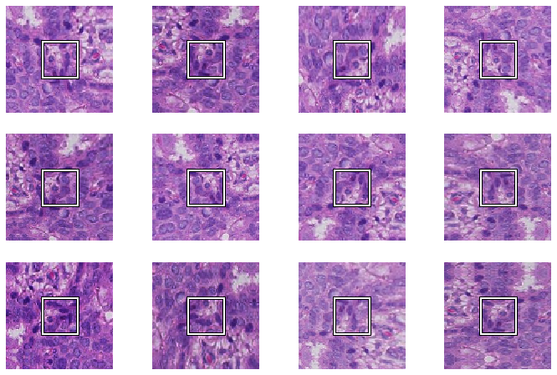
Data Augmentation
Transforms performed on this dataset:
Image resizing
Random cropping
Horizontal/Vertical axis flipping
Following augmentation, batch size
is fixed and the images are normalized

Slide 18
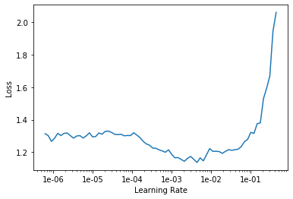
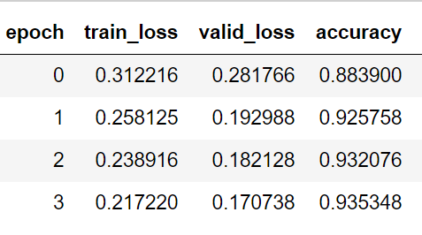
Fit One Cycle
learn = cnn_learner(data, models.resnet50, metrics=accuracy)
learn.fit_one_cycle(4)
>The accuracy is 93.53482818603516 %
learn.lr_find()

Slide 19
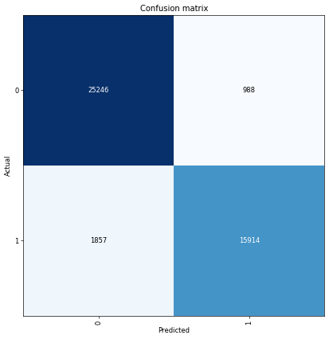
Classification Interpretation
interp=ClassificationInterpretation.from_learner(learn)
interp.plot_confusion_matrix(figsize=(7,7),dpi=60)

Slide 20
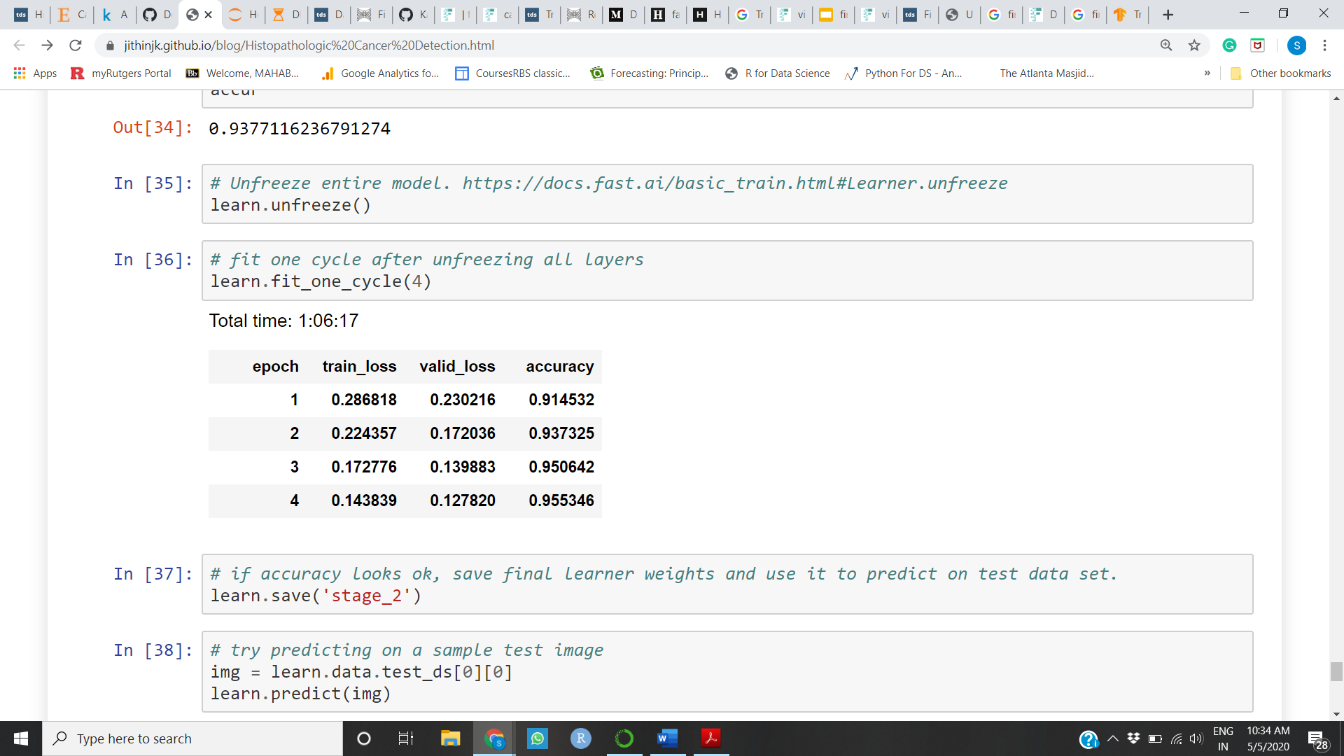
Fine-Tuning
Jointly train both all classifier layers of the base mode
Fine-tune the higher-order feature representations in the base model
Transfer learning + Fine-tuning = Better Generalisation
learn.unfreeze()
learn.lr_find()
learn.fit_one_cycle(4)
> The accuracy is 95.53462818603516 %
Unfreeze layers of the frozen model base

Slide 21
Inference
95%
ResNet 50
Steady epoch: 3rd
Epoch time: 13: 17
93%
AlexNet (0.3)
Steady epoch: 8th
Epoch time: 2:93
90%
AlexNet (0.4)
Steady epoch: 6th
Epoch time: 2:83
84%
VGG 16
Steady epoch: 4th
Epoch time: 2:41
80%
VGG 13
Steady epoch: 3rd
Epoch time: 1:97

Slide 22
Thank You

